Slide 1
Initiation à l’agilité informatique - 1
Découpage d’un projet de façon itérative

Slide 2
Qu’est-ce que l’agilité informatique?
… à vos post-its !

Slide 3
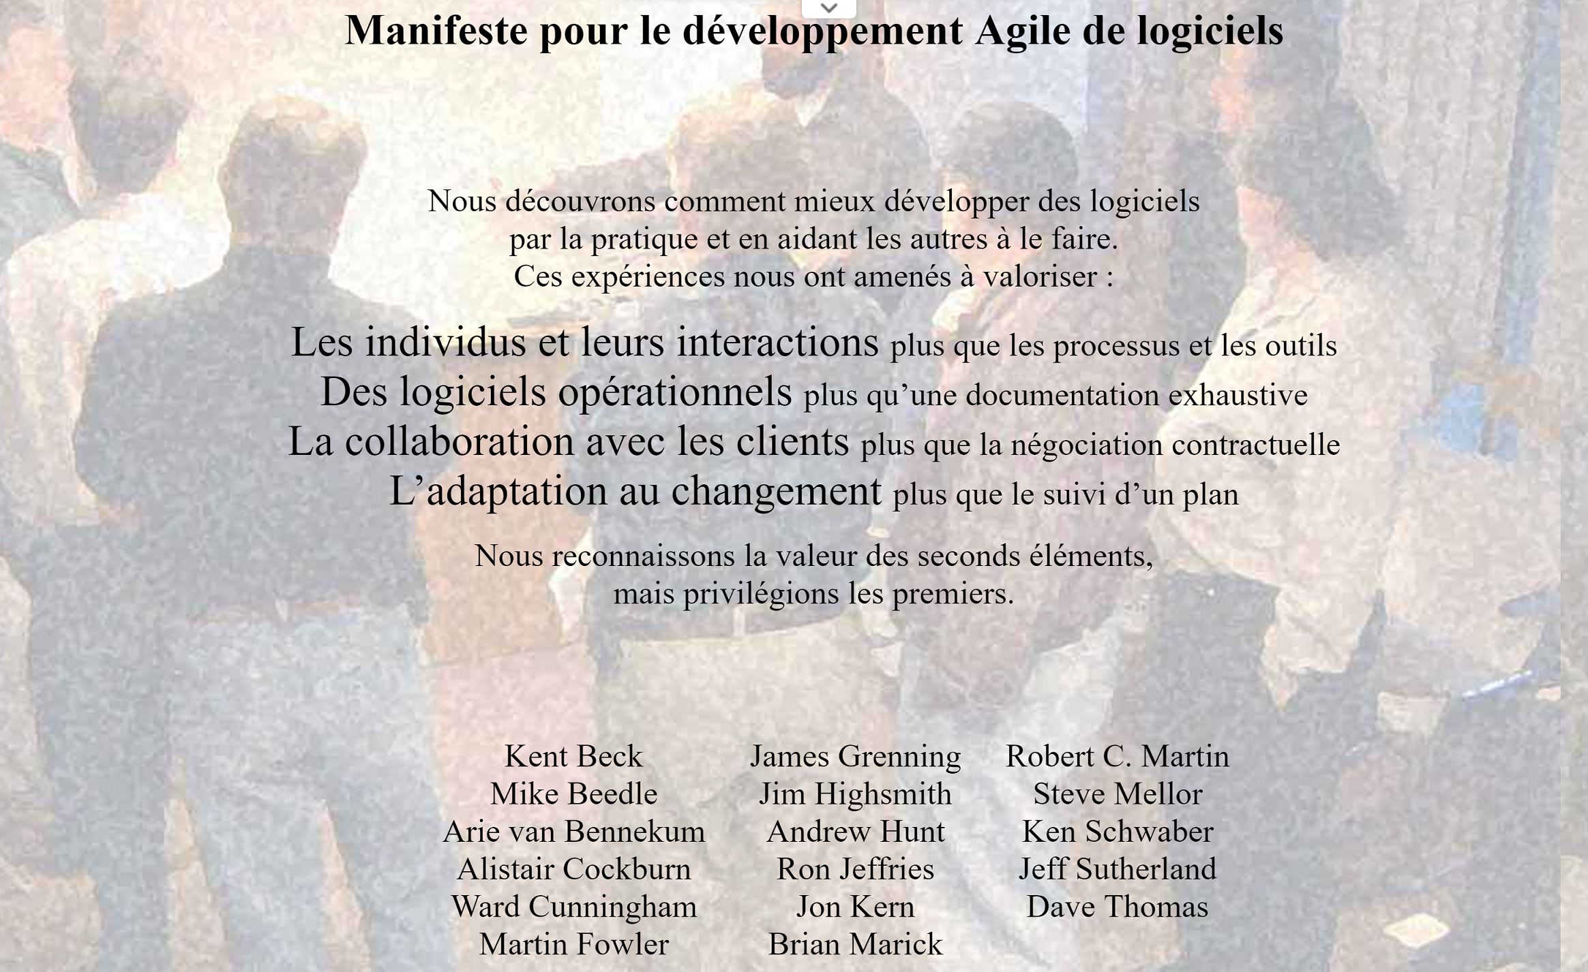

Slide 4
Cycle en « V » versus méthode itérative

Slide 5
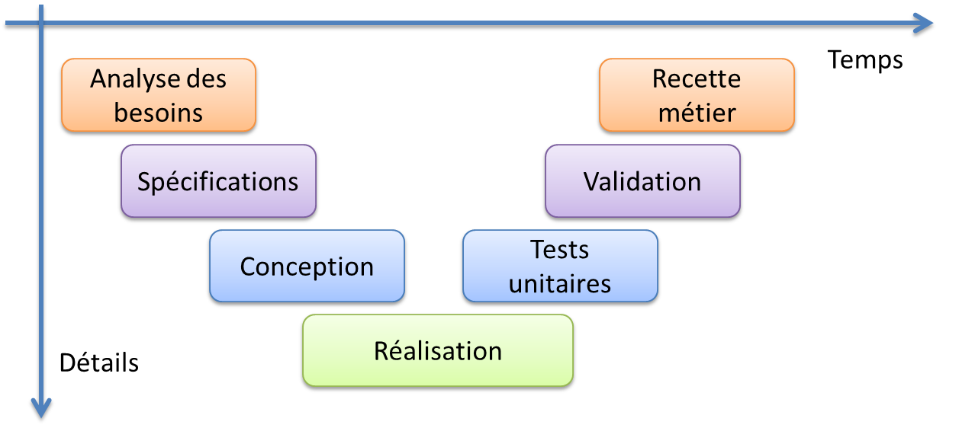
Le Cycle en « V »

Slide 6
Inconvénients
Investissement initial important
Application monolithique
Campagne de test lourde
Mise en production… hé, comment dire…
Période de stabilisation suite à la MEP
Effet tunnel
Péremption du produit
Fatigue des équipes

Slide 7
Avantages

Slide 8
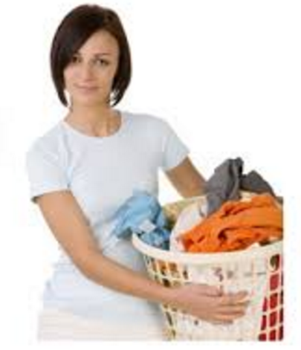

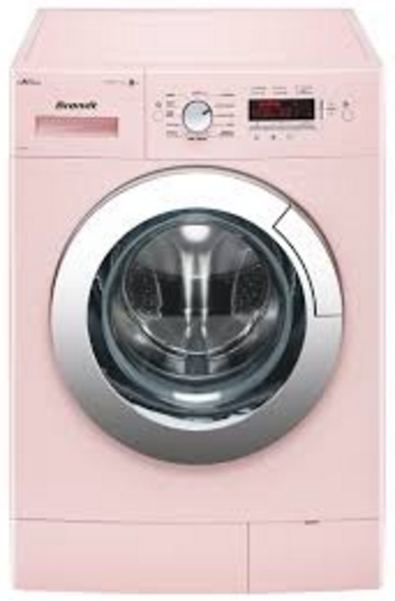

Méthode itérative Commençons par un exercice !
Pouvez-vous faire une machine à laver rose qui fait de la musique ?
OK !

Slide 9


6 mois plus tard…
C’est génial ! Mais, pourriez-vous plutôt me mettre la télé ?
Bouhhh ☹

Slide 10
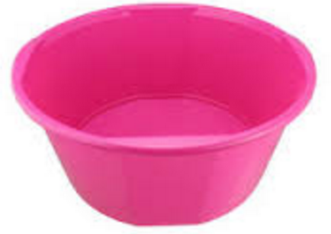

Une autre approche…
Lorsque je fais ma lessive, j’aime écouter de la musique
OK !

Slide 11
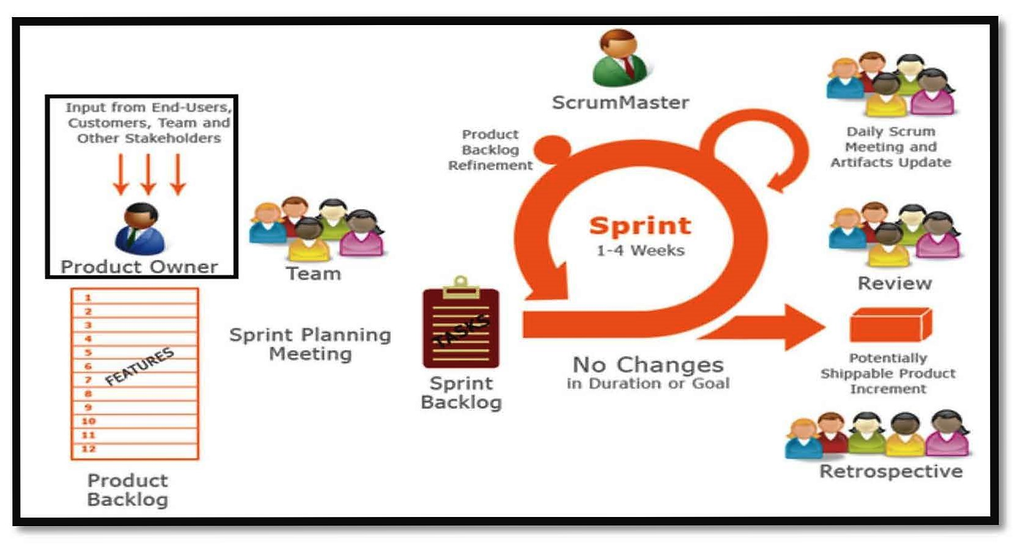
Méthode itérative

Slide 12
Découpage de façon itérative

Slide 13
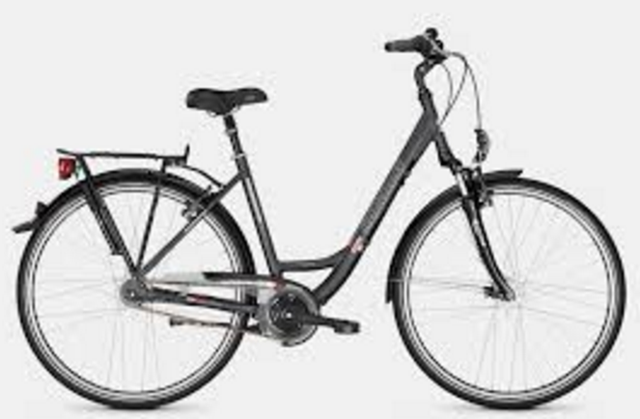
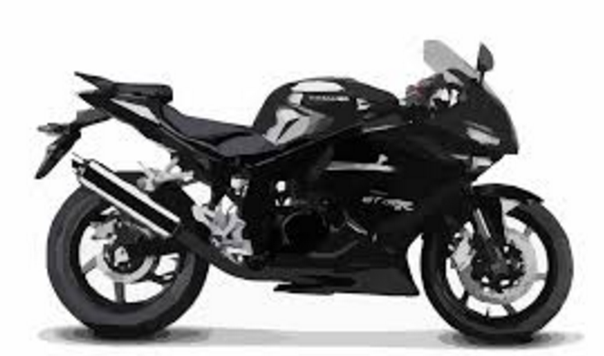
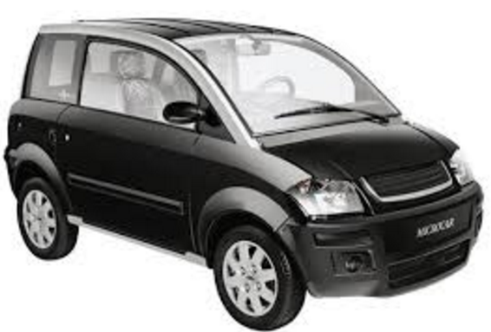
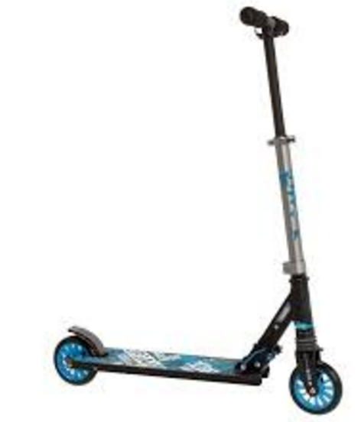
Utilisons une métaphore!
Je veux pouvoir aller d’un endroit à un autre

Slide 14
Minimum Marketable Feature
Trouver la plus petite fonctionnalité qui a de la valeur pour l’utilisateur
Procéder de manière itérative
Livrer souvent de petites fonctionnalités => le système est toujours stable et utilisable

Slide 15
User Story
Chaque MMF est découpée en User Story
Une US a un ou plusieurs Critères d’acceptance
Un ou plusieurs critère(s) d’acceptance est rédigé en Gerkin:
Given
When
Then

Slide 16
Behaviour Driven Developpement
Feature: Some terse yet descriptive text of what is desired
In order to realize a named business value
As an explicit system actor
I want to gain some beneficial outcome which furthers the goal
Scenario: Some determinable business situation
Given some precondition
And some other precondition
When some action by the actor
And some other action
And yet another action
Then some testable outcome is achieved
And something else we can check happens too
Scenario: A different situation
...

Slide 17
Un test fonctionel interprété par le code
/**
* @Given /the following people exist:/
*/
public function thePeopleExist(TableNode $table)
{
$hash = $table->getHash();
foreach ($hash as $row) {
// $row['name'], $row['email'], $row['phone']
}
}

Slide 18
La fonctionnalité (feature)
Feature: Serve coffee
In order to earn money
Customers should be able to
buy coffee at all times
Scenario: Buy last coffee
Given there are 1 coffees left in the machine
And I have deposited 1 dollar
When I press the coffee button
Then I should be served a coffee

Slide 19
Le scénario
Scenario: Wilson posts to his own blog
Given I am logged in as Wilson
When I try to post to "Expensive Therapy"
Then I should see "Your article was published."
Scenario: Wilson fails to post to somebody else's blog
Given I am logged in as Wilson
When I try to post to "Greg's anti-tax rants"
Then I should see "Hey! That's not your blog!"
Scenario: Greg posts to a client's blog
Given I am logged in as Greg
When I try to post to "Expensive Therapy"
Then I should see "Your article was published."

Slide 20
Scenario Outline
Scenario Outline: Eating
Given there are <start> cucumbers
When I eat <eat> cucumbers
Then I should have <left> cucumbers
Examples:
| start | eat | left |
| 12 | 5 | 7 |
| 20 | 5 | 15 |

Slide 21
Le contexte (background)
Feature: Multiple site support
Background:
Given a global administrator named "Greg"
And a blog named "Greg's anti-tax rants"
And a customer named "Wilson"
And a blog named "Expensive Therapy" owned by "Wilson"
Scenario: Wilson posts to his own blog
Given I am logged in as Wilson
When I try to post to "Expensive Therapy"
Then I should see "Your article was published."
Scenario: Greg posts to a client's blog
Given I am logged in as Greg
When I try to post to "Expensive Therapy"
Then I should see "Your article was published."

